Slide 1
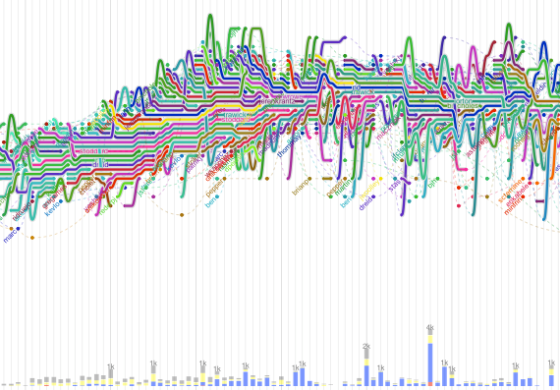
Software Maintenance and Evolution CSSE 575: Session 9, Part 2 A Model for Evolutionary Growth
Steve Chenoweth
Office Phone: (812) 877-8974
Cell: (937) 657-3885 Email: chenowet@rose-hulman.edu
The Apache Webserver evolution “storyline,” from http://flowingdata.com/2010/10/12/software-evolution-storylines/.
Notes:
Some material for this discussion taken from Software Evolution, by Tom Mens and Serge Demeyer (Eds), Springer, 2010, ISBN – 978-642-09529-0.

Slide 2
In the beginning…
Prior to the 1970’s, the model for software development was like that of releasing any other product
The main effort should be getting it out the door.
The follow-on activities should be minimized
These sounded like repair work.
Work like the IBM OS/360 project led to the notion that software was different –
Maintenance and enhancement was more likely to be ongoing
Above – A depiction of the Big Bang, from http://scienceblogs.com/startswithabang/2010/07/the_last_great_prediction_of_t.php.

Slide 3
As a result…
Where once there was a waterfall, we got the spiral and iterative lifecycle models.
The problems of software aging were recognized:
Architecture deteriorates under the load of features originally not anticipated.
Lehman started adding more laws to his model!

Slide 4
All the remedies are partial…
Agile development, for example:
Fast initial creation of a product.
Emphasis on prioritizing what’s important to do next.
But unclear if the overall structure will last.

Slide 5
“Software evolution” is…
A respected research area. Sub topics:
“What and why” – analyzing the inevitabilities
“How” – improved processes
Where most of us live, as software developers
Includes all the types of maintenance –
Perfective
Corrective
Adaptive
Preventive

Slide 6
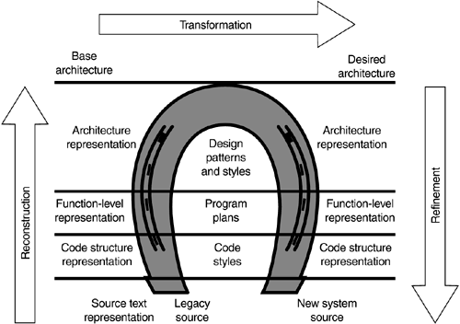
Reverse and re-engineering
Recall the model!
Reverse – seems like the avoidable one!
Can also be seen as the start of any new project.
Includes “how the same job is done now” in analyzing requirements.
Reengineering –
The “horseshoe model” describes it. →
Refactoring is a part of that.
Visualizations (see last discussion!) can be very useful in understanding the existing system.
Above – a fairly fancy version of the “horseshoe model,” from http://learning.infocollections.com/ebook%202/Computer/Microsoft%20Technologies/General/Modernizing_Legacy_Systems/0321118847_ch05lev1sec2.html.

Slide 7
Two possible reengineering goals
Restructuring – do major surgery on the existing system.
E.g., rearchitect it to allow more features to be added.
E.g., redesign for a new environment.
Like “make it SOA instead of a product installed remotely.”
Forward engineering – build an entirely new system to replace this one.

Slide 8
Ingredients of successful evolution - 1
Incremental changes (what we do all the time) –
Program comprehension by the maintainers
Impact analysis:
Includes forecasting what a change will cost!
Refactoring or restructuring often is needed.
Validation and verification:
Regression testing
Adding tests for the new / changed features

Slide 9
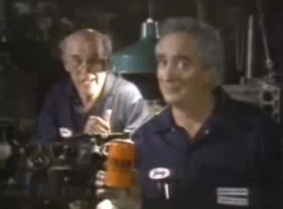
Ingredients of successful evolution - 2
Large-scale changes (like restructuring or rewriting the system) need to consider these issues:
Require time spent working on things that don’t look like “features” – always a show stopper.
The same managers who didn’t want time spent on “architecture” earlier, may now be shocked to hear that you’re about to lose 6 months to rewrite the whole thing.
Need sufficient metrics to know when the design is crumbling!
Above – The Fram oil filter “pay me now or pay me later” guys.

Slide 10
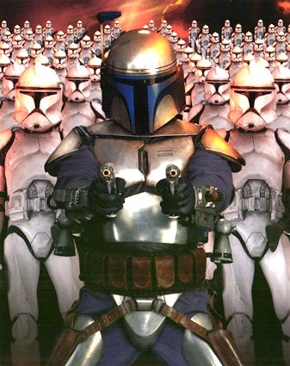
Ingredients of successful evolution - 3
Intermediate-level changes – something we do periodically.
E.g., “search and destroy of software clones.”
Changing big processes, like how repositories and load lines function.
Analyzing bug report histories to decide how to get rid of a bunch all at once.
Above - Star Wars Episode 2: Attack of the Clones poster.

Slide 11
Software improvement
We all know that “improving the associated processes” is important.
A key part of this is “detecting” the problems in systematic ways.
As a system grows, it needs more and more ways to look for related issues.

Slide 12
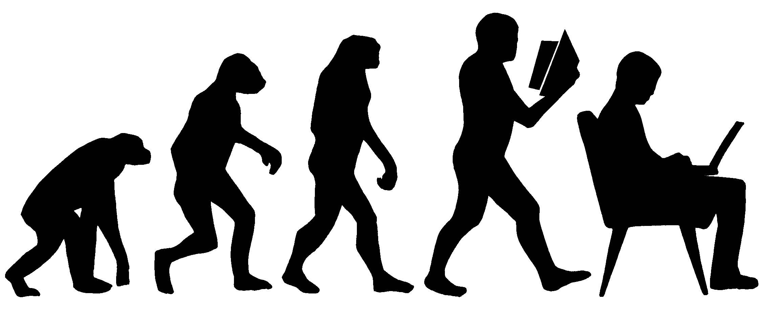
What evolves?
Requirements
Architecture
The data that the system uses
The runtime environment
Increasingly, these can’t be “stopped” to upgrade!
Switching – like from a product to SOA
Languages and tools
Notes:
Evolution cartoon from http://blog.zopim.com/2013/11/28/evolution-sale/.

Slide 13
Sample Theory Paper - 1
Bastani & Bastani
SIGSOFT article by Bastani & Bastani (2007)
Main ideas:
Most research on evolvable systems has been in a specific domain.
Can we design systems generally, that can adapt to new requirements?
What’s an efficient methodology for a system when we don’t know the boundaries?
Suggest a “DNA replication process”
E.g., have a framework to fill in for enhancements

Slide 14
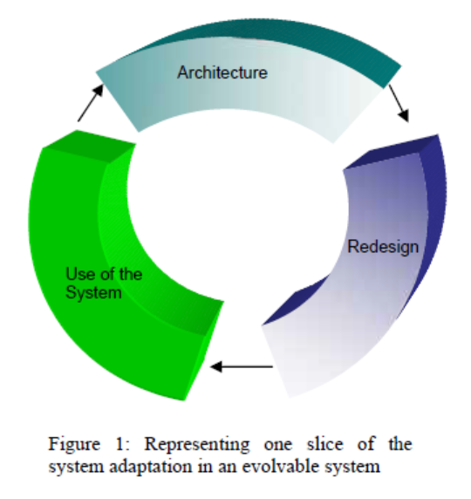
Sample Theory Paper - 2
Bastani & Bastani
What do the authors mean by “evolvable”?
User adaptation (requirements & preferences)
Environmental adaptation
Includes responding to context changes dynamically
System needs to accept modifications at all levels (including architectural).
An “Evolvable System” can adapt to these.
An “Open System” is not rigidly controlled by a central authority.

Slide 15
Sample Theory Paper - 3
Bastani & Bastani
The authors describe a variety of things an open, evolvable system would have to do.
They generalize these descriptions as much as possible.
E.g., “We believe for a system to be evolvable, it needs to be fundamentally as disintegrated as possible.” I.e., it should be built through Composition versus Inheritance.

Slide 16
Sample Theory Paper - 4
Bastani & Bastani
The genetic analogy comes from their conceptual requirement # 3:
The operational synonymity¹ of writing the software system and running it.
Suggests this must be done from some “roadmap” – a pattern or framework or style sheet.
In the rest of the paper, they mine this DNA analogy.
They look at what a system “does” rather than what it “is” as the key to making an evolvable system.
Needs a “process model.”
This is all, clearly, research!
¹Synonymity - the semantic relation that holds between two words that can (in a given context) express the same meaning

Slide 17
Assignment and Milestone Reminders
Related topics to Journal about (save for week 9 if we discuss earlier!):
How often has your system needed major changes to its underlying design?
What areas has this been in? Is it predictable?
What are the “intermediate level” changes that you have made periodically?

